Slide 1
Tutorial 7 Virtual Memory and Address Translation
Tutor: Luo Qin
qluo22@cse.cuhk.edu.hk

Slide 2
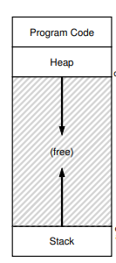
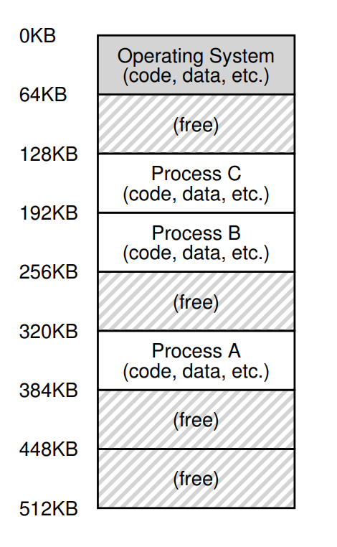
An Overview of the Memory Space Under Multi Processes
Isolation, Protection and User-friendly
OS Kernal
Aspect
Programmer Aspect
Two techniques:
Segmentation
Paging

Slide 3
Segmentation

Slide 4
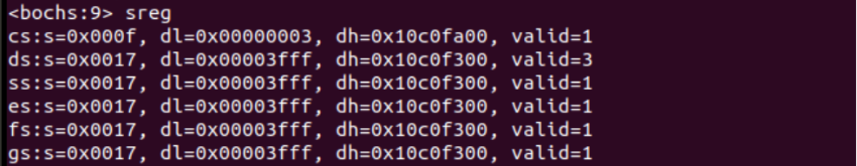
Segmentation
Programmer Aspect
0
Index | Segment | Base | Size
0 | Code | 0K | 8K
1 | Heap | 8K | 12K
2 | Stack | 64K | 12K
8KB
0
12KB
Segment Descriptor
12KB
Logical Address = Segment Base Address + Offset
0

Slide 5
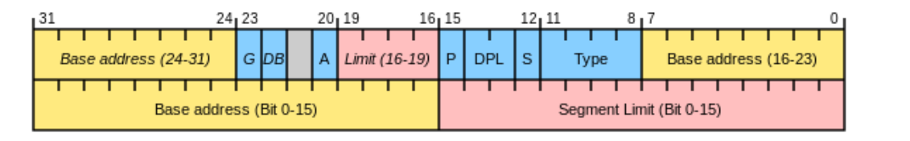
Segment Descriptor
Implementation in x86 and x86-64 (32-bit machine)
Segment Descriptor
We could get the address that the segment starts and the length from Segment Descriptor!
The base address and limit differs for different segment and the processes.

Slide 6
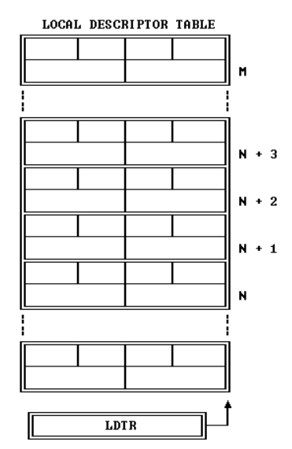
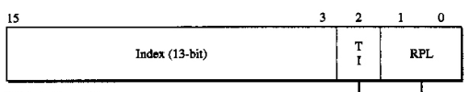
Local Descriptor Table
Implementation in x86 and x86-64 (32-bit machine)
How to store the segment information for each process?
LDT (local descriptor table)
Store the segment descriptor for each process stored in memory.
How to switch the LDT when the context switch happens?
Change the value in LDTR
LDTR (local descriptor table register)
Store the start address of LDT
The structure of LDTR is like segment descriptor.
How to select each segment (Code\Slack\Heap) from the LDT?
Segment Selector: Determine the Index of Segment Descriptor
Segment M
Segment
N+3
Segment
N+2
Segment
N+1
Segment
N

Slide 7
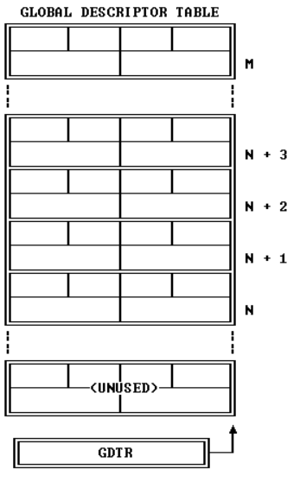
Global Descriptor Table
Implementation in x86 and x86-64 (32-bit machine)
From the OS kernel, the record of the LDT starting
address of each process is needed.
GDT(global descriptor table)
Store the information of LDT of each process
Located in the OS kernel memory space
The starting address in GDT is stored in
GDTR (global descriptor table register)
Process
M
Process
N+3
Process
N+2
Process
N+1
Process
N

Slide 8
Segmentation
LDT
Offset
Segment Selector
Base Address
GDT
Virtual(Linear) Address
Process Selector

Slide 9
Paging

Slide 10
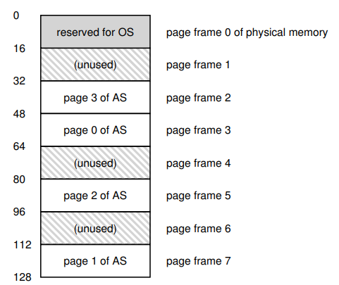
Paging
Convenient for free space management
Reduce the wasted fragmentation
(not larger than 1 page size)
Allowing the memory space of one process
discontinuous
Creating large virtual memory space within
small memory

Slide 11
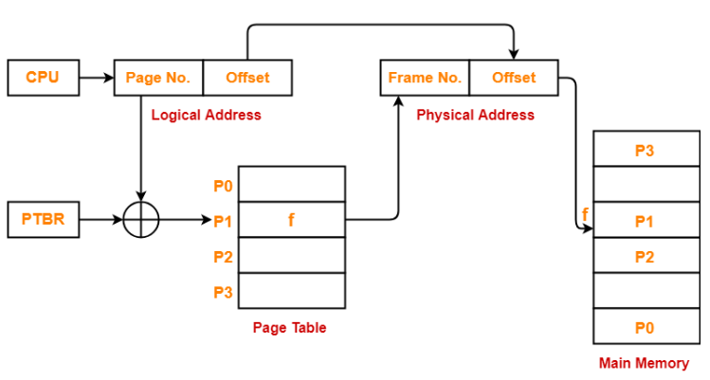
Paging
Page Table
The size of one page?
The size of the page table?

Slide 12
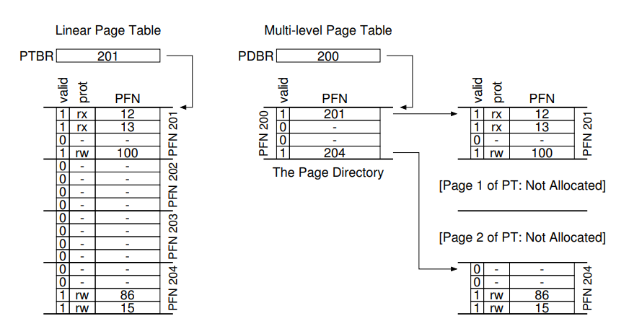
Multi-level Page Table
Motivation: Reduce the memory space for storing the page table when the virtual
address space is large.
Method: Do not allocate the memory to construct page table for invalid item.

Slide 13
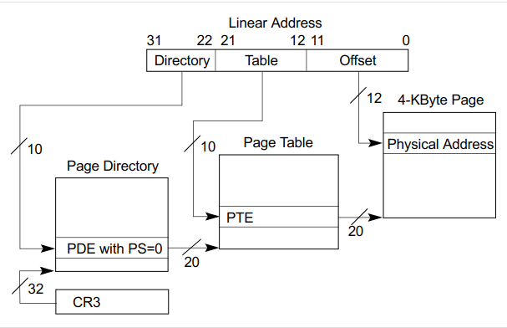
Multi-level Page Table
The two level page table in x86 and x86-64 (32-bit machine)
10
10
12

Slide 14
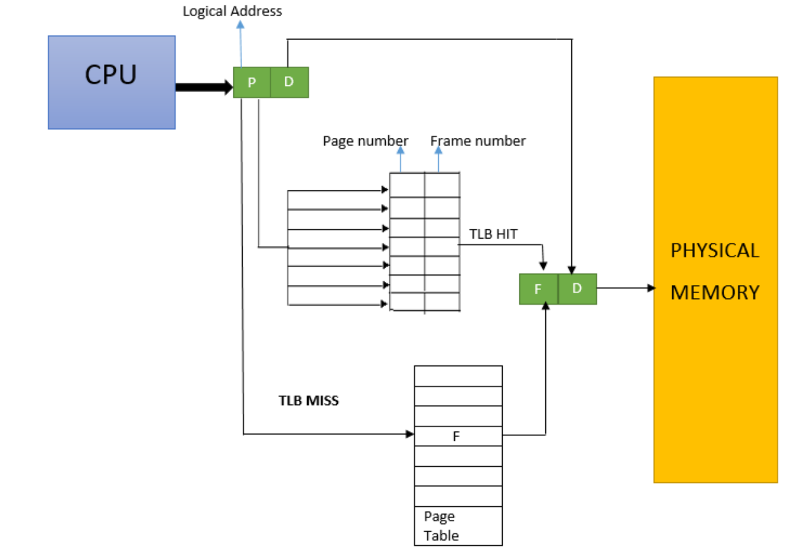
Translation Look-aside buffers (TLB)
Motivation: The time overhead of frequent visiting of multi-level page table is
high
Method: The idea of cache. Saving the frequently visited items in the cache.

Slide 15
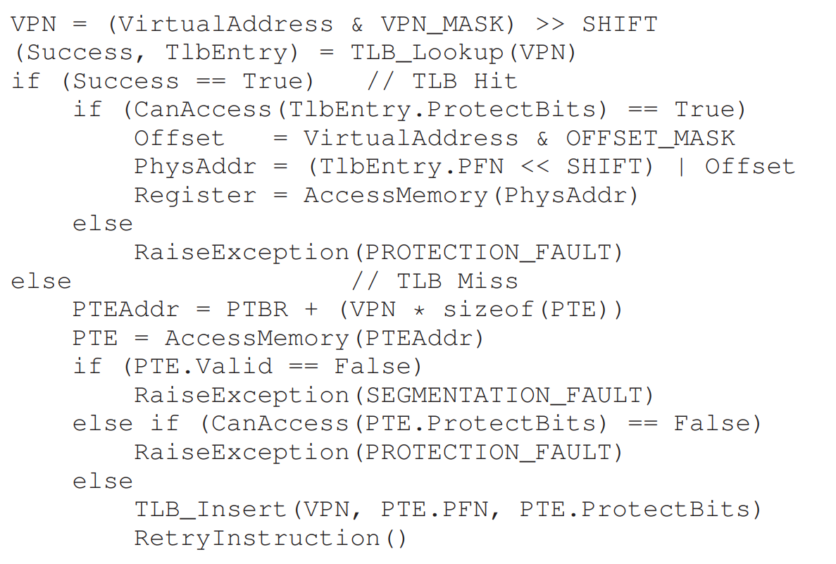
Translation Look-aside buffers (TLB)
Finding the physical address using TLB

Slide 16
Address Translation

Slide 17
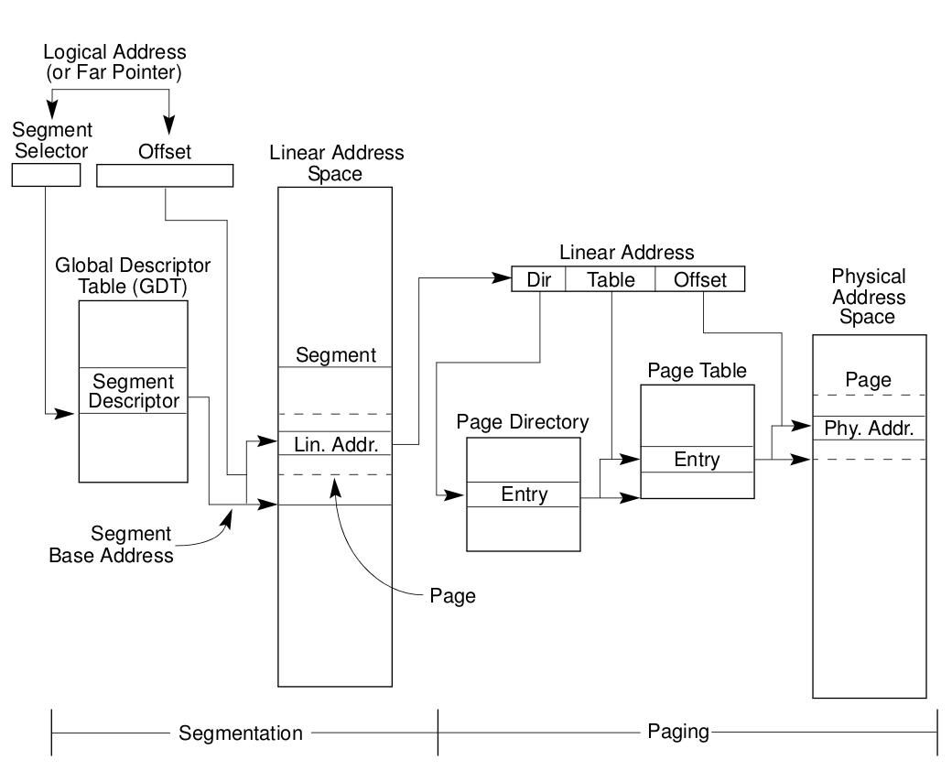
Address Translation
MMU

Slide 18
Case Study: A journey to ‘i’ in linux-0.11

Slide 19
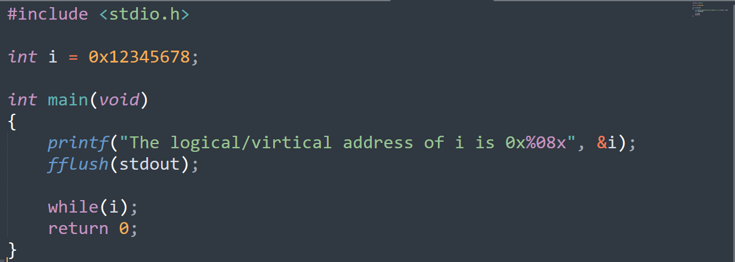
Problem Setting
Initialize ‘i’ with non-zero value, but when it meets while(i): Infinite loop
Objective: Look into the os kernel. Find the physical address of variable ‘i’ and make its value zero to
terminate the indefinite loop. (Some thing exotic but interesting!)

Slide 20
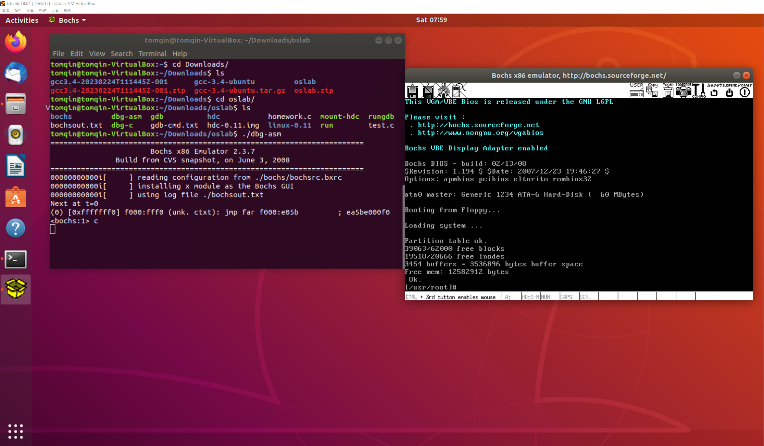
Environment Setting
Environment Setting (Required)
VirtualBox + Ubuntu-18.04
g++3.4 & gcc 3.4
Bochs IA-32 Emulation Platform
Linux-0.11 source code (oslab code)
The setup instruction of the lab environment
would be given to you.
Bochs: Simulating the linux-0.11

Slide 21
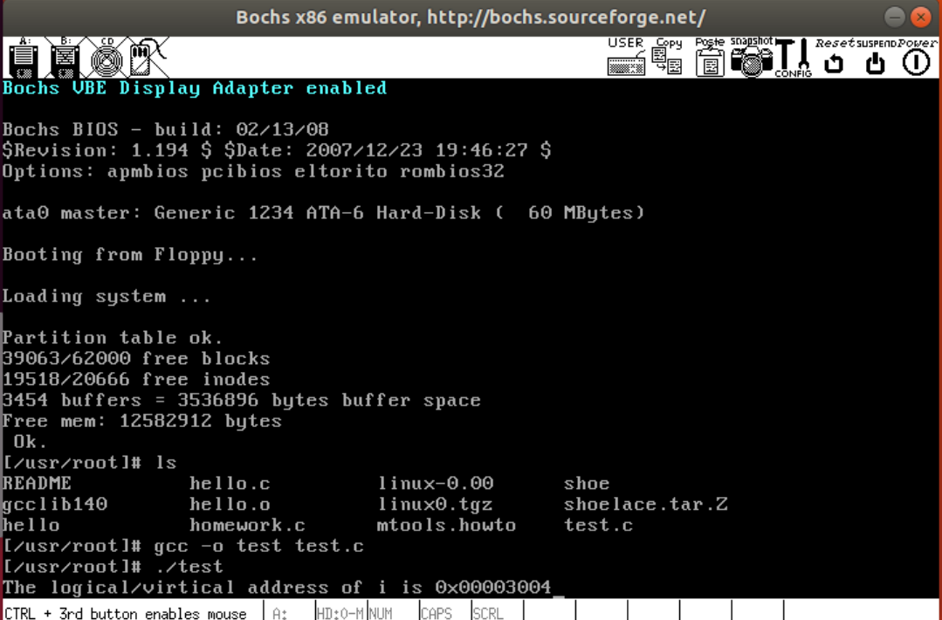
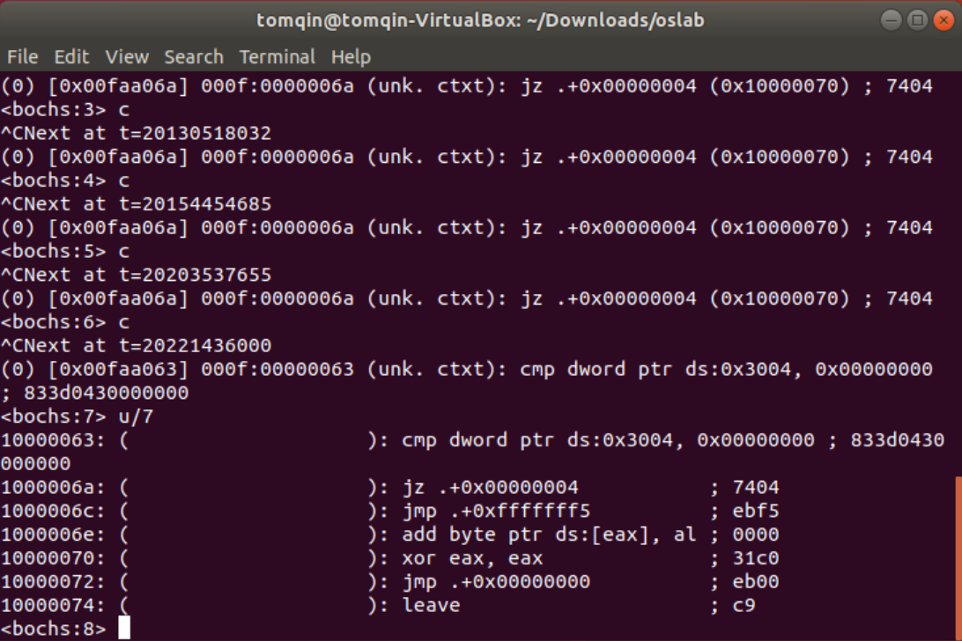
Finding the Logical Address of ‘i’
printf("The logical/virtical address of i is 0x%08x", &i);
The offset address of ‘i’ is 0x00003004
Setting breakpoint in Bochs:
Ctrl+c: pause current program
c: continue to run the program
cmp dword ptr ds:0x3004, 0x00000000 ; 833d0430000000
(Assembly language for i==0)
The logical address of ‘i’ is ds: 0x3004. The segment register
is ds. The offset is 0x00003004.

Slide 22
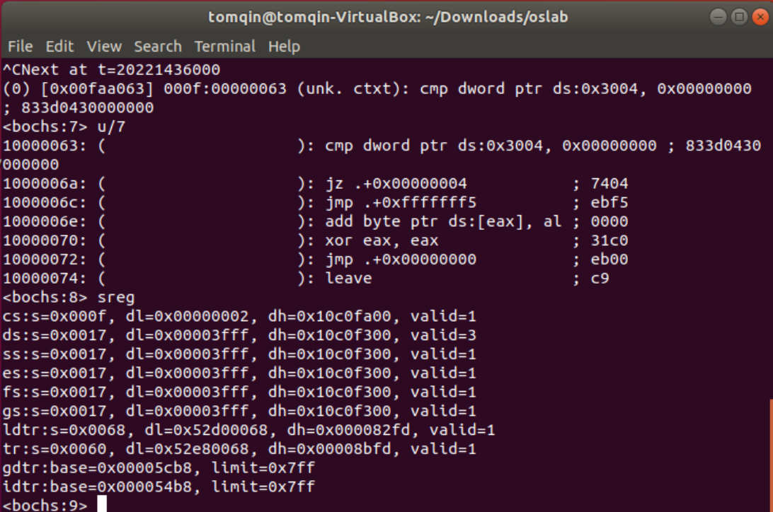
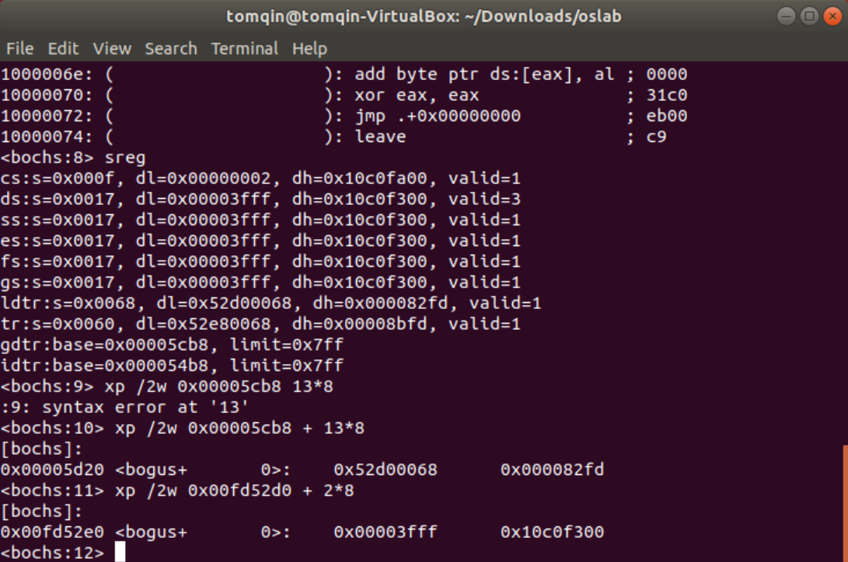
Finding the Logical Address of ‘i’
Find the starting address of segment using ds
sreg
Check the segment register
ds segment descriptor
0x00003fff 0x100f300
The base address of ds segment is:
0x10000000
The logical address of ‘i’:
0x10000000+0x00003004=0x10003004
We could check whether the segment descriptor
is correct using ldtr, gdtr and selector
base offset

Slide 23
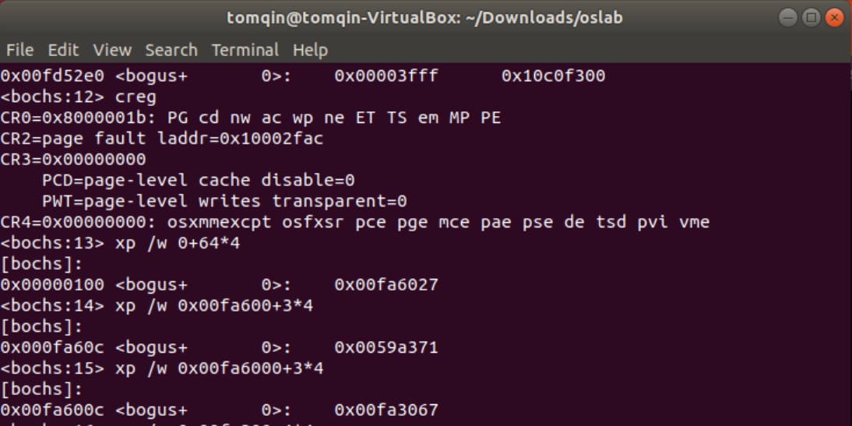
Finding the Physical Address of ‘i’
Logical address of ‘i’ is 0x10003004
Two-level page table
The first-level page number (10-bit) is: (binary) 0001000000=64
The second-level page number (10-bit) is: (binary) 0000000011=3
The offset (12bit): 0x004 = 4
The starting address of first-level page table
creg
Check the control register
CR3 = 0x00000000
The starting address of second page table:
0x00fa6000
The starting address of page where ‘i’ stores:
0x00fa3000
(Simply the 20 bit represents the address
Information)

Slide 24
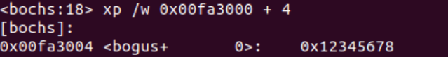
Finding the Physical Address of ‘i’
The starting address of page where ‘i’ stores:
0x00fa3000
Physical Address: 0x00fa3000+0x00000004=0x00fa3004
Set the value in 0x00fa3004 to 0

Slide 25
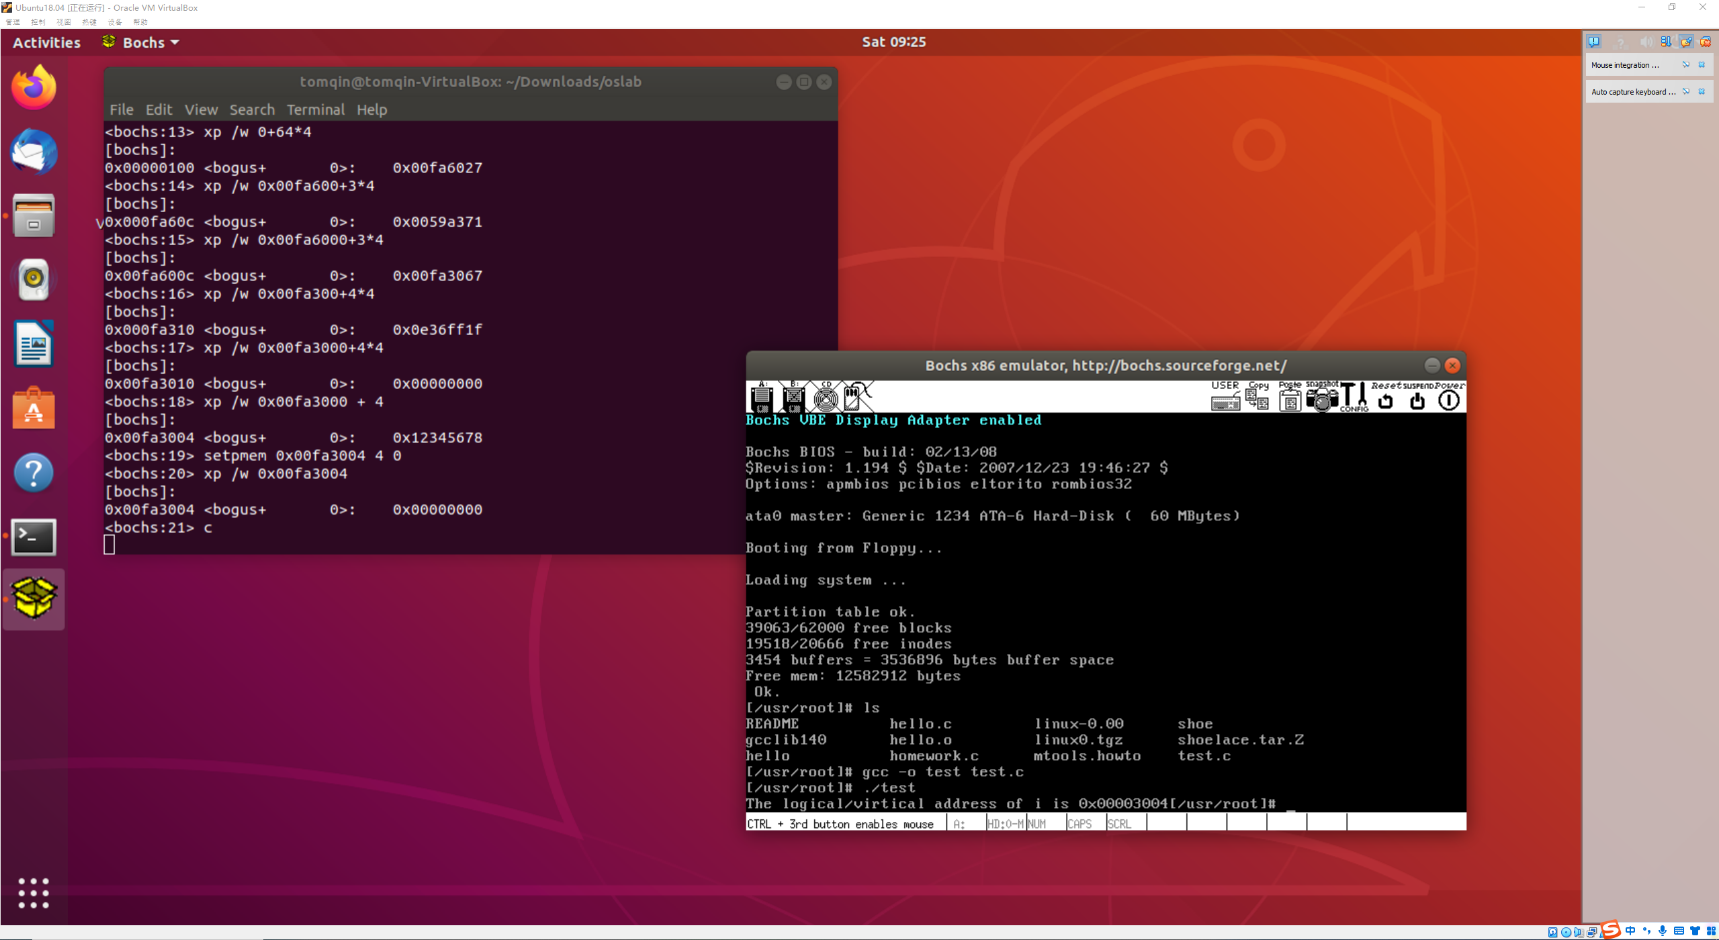
Continue And ?
Press c to continue and we exit the indefinite loop! Excited!
A similar but more interesting task might be given to you as homework

Slide 26
Any Question?

